Slide 1



SMART INDIA HACKATHON 2026
Problem Statement ID –25008
Problem Statement Title-Farmers often face long waiting times, lack of information regarding procurement schedules, and uncertainty about procurement status.
Theme- Smart Automation
PS Category- Software
Team ID-26
Team Name – Syntax Error

Slide 2
AI-Powered Farmer Procurement Slot & Queue Management Platform
Proposed Solution (Resolution)
Traditional Solutions
Farmer Registration & Slot Booking
Digital Token & Real-Time Queue Tracking
SMS/App Notifications & Alerts
Procurement Status Tracking
Payment Status Updates
AI-based Crowd & Waiting-Time Prediction
Admin Dashboard for Real-Time Monitoring
Long waiting hours at procurement centres
No clear information about procurement schedules
Unmanaged queues and overcrowding
Uncertainty about when their produce will be procured
Limited communication regarding slot/status updates
Lack of visibility into payment status
Repeated trips to procurement centres

Slide 3
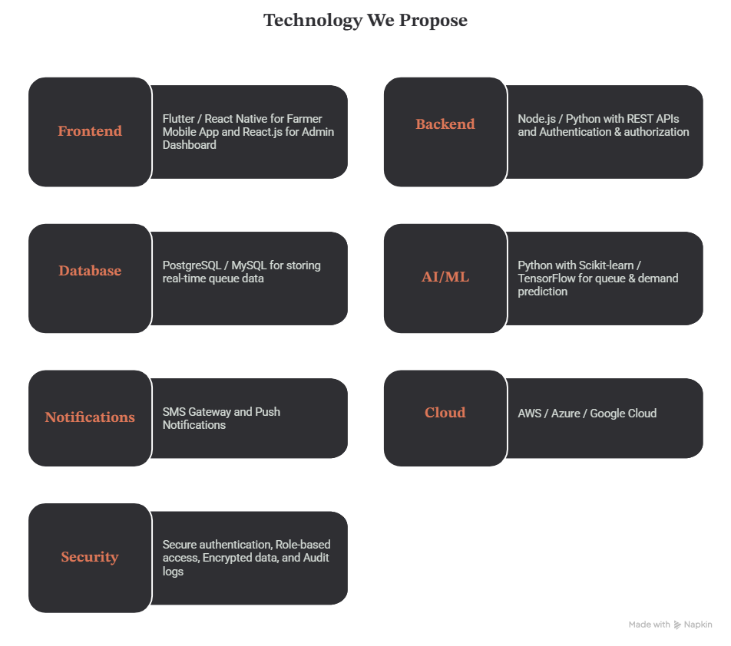
TECHNICAL APPROACH

Slide 4
Feasibility & Viability
Feasibility
Viability
Technically Feasible — Uses proven technologies like mobile apps, cloud, APIs, AI/ML, and SMS.
Cost Effective — Can be developed using open-source tools and scalable cloud services.
Easy to Adopt — Simple, multilingual interface for farmers and officials.
Scalable — Can start with one procurement centre and expand statewide.
Government Compatible — Can integrate with existing procurement and payment systems.
High Impact — Reduces queues, waiting time, congestion, and unnecessary travel.
High Farmer Adoption — Simple mobile + SMS-based access.
Low Operational Cost — Digital process reduces manual workload.
Scalable — Can expand from one centre to district/state level.
Sustainable — Reduces paper, congestion, and unnecessary travel.
Government Benefit — Better monitoring, planning, and transparency.
Long-Term Potential — Can integrate with other agriculture services

Slide 5
IMPACT AND BENEFITS
Your Team Name
Impact on Target Audience 🎯
Farmers: Less waiting, fewer trips, and better transparency.
Procurement Centres: Reduced congestion and smoother operations.
Officials: Real-time monitoring and better resource planning.
💰 Government: Improved efficiency, accountability, and farmer satisfaction.
Benefits 🌍
Saves farmers’ time
Easy slot booking
Reduces overcrowding
Real-time notifications
Easy payment status tracking
Efficient centre management
AI-driven queue optimization

Slide 6
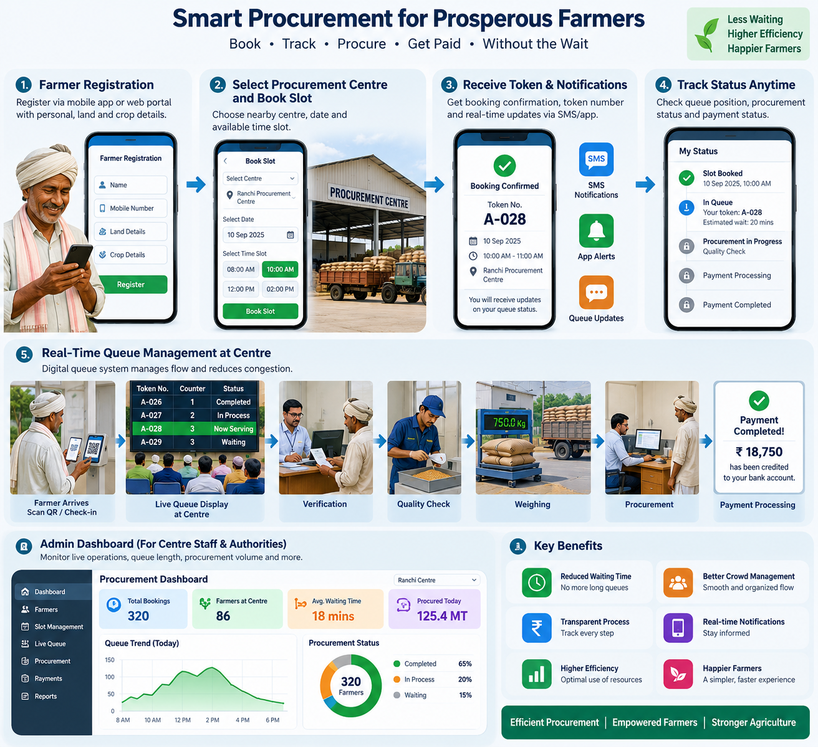
Web app overview

Slide 7
RESEARCH AND REFERENCES
Your Team Name
NDMA (National Disaster Management Authority) – https://ndma.gov.in
IMD (India Meteorological Department) – https://mausam.imd.gov.in
UNDRR – Disaster Risk Reduction Guidelines – https://www.undrr.org
Sendai Framework for Disaster Risk Reduction – https://www.undrr.org/sendai-framework
World Bank Report on School Safety & Disaster Preparedness – https://www.worldbank.org/en/topic/disasterriskmanagement
Research Paper: “Gamification in Disaster Preparedness Education” – International Journal of Disaster Risk Reduction (2023)

